Slide 1
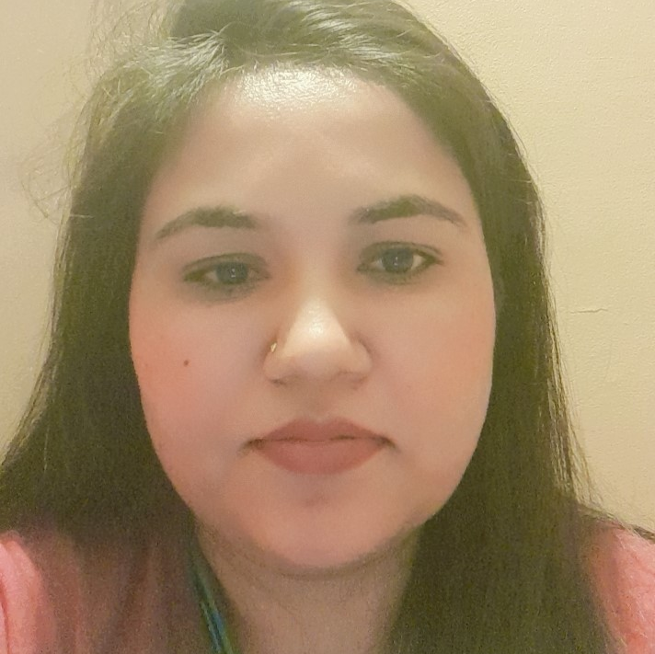
Anuja Shukla
ISTQB
AGILE Software Dévelopment –Coursera
AWS Cloud Technical Essentials – Coursera
Career
Team Lead in TCS
QA tester in CG
Team Lead in CG
Skills
UNIX
Oracle PLSQL
ITIL Tools : HPSM, Service Now
JIRA, Autosys Basics
GIT Basics
BFS, FX domain
Manual Testing
Python Basics
Production Support
Team Lead, Manual Tester
Team Lead, Tester : Nationale Netherlands
Team Leadership: Managed offshore operations for a 10+ member team.
Security Document Approval: Created and presented a comprehensive security document, earning client appreciation.
Operational Efficiency: Drove initiatives for streamlined workflows, contributing to on-time and within-budget delivery of a database migration project.
Testing Excellence: Conducted meticulous manual testing, ensuring data accuracy and stability post-migration, collaborating with cross-functional teams for issue resolution.
QA Tester : Morgan Stanley
End-to-End Testing Leadership: Orchestrated comprehensive end-to-end functional and regression testing processes.
Spearheaded QA testing for the EV Portal Application, assessing trader/salesperson volume flow for optimal performance within the trading forum.
Streamlined Test Documentation.
Team Lead : MUFG
Production Support Leadership: Led a 24x7 team overseeing incidents for 300+ applications, prioritizing resolutions for critical issues, and ensuring minimal downtime, particularly for account generation and transaction processing applications.
Addressed recurring issues proactively, collaborating across teams to analyse root causes, propose effective solutions, and enhance overall system stability.
Over 10.9 Years of IT Expertise: Seasoned professional with a decade of experience in production support management, manual testing, and personnel management.
Technical Proficiency: Skilled in Linux, PLSQL, Manual Testing(Regression, Functional)
Significant contributions to renowned organizations like TCS and Capgemini, reflecting a strong commitment to excellence and success.
Key Strengths in Communication and Strategy: Demonstrated excellence in communication, creativity, and strategic thinking, enhancing project outcomes and driving success.
Versatility Across Technologies: Demonstrated versatility to pivot across technologies and domains, with a track record of successful project contributions in diverse and challenging environments.

